Slide 1
HR Employee Attrition Analysis: Using Random Forest for Classification
Mohamed Souleimane Cheikh Ahmed
06/01/2025

Slide 2
01
Introduction

Slide 3
I'll be presenting my project for Machine learning applications in business. The focus is on analyzing the HR Employee Attrition dataset, exploring its importance to businesses, and using machine learning algorithms to gain insights and make predictions. Let's dive in.

Slide 4
02
Dataset Overview

Slide 5
The dataset I'm using is the HR Employee Attrition dataset, sourced from Kaggle. It contains data for 1,470 employees across 35 columns.
These columns include a mix of categorical and numerical variables, such as 'Age,' 'Attrition,' 'Department,' and 'Monthly Income.' This dataset gives us detailed employee-level information.

Slide 6
Summary Table
Attribute | Value
Total Rows | 1470
Total Columns | 35
Target Variable | Attrition(Yes/No)
Numerical Columns | 26
Categorical Columns | 9
Missing Values | None

Slide 7
Key categorical variables
 | Unique Values | Count
Attrition | ['Yes', 'No'] | 2
Business travel | ['Travel_Rarely', 'Travel_Frequently', 'Non-Travel'] | 3
Department | ['Sales', 'R&D', 'HR'] | 3
Marital status | ['Single', 'Married', 'Divorced'] | 3
Overtime | ['Yes', 'No'] | 2

Slide 8
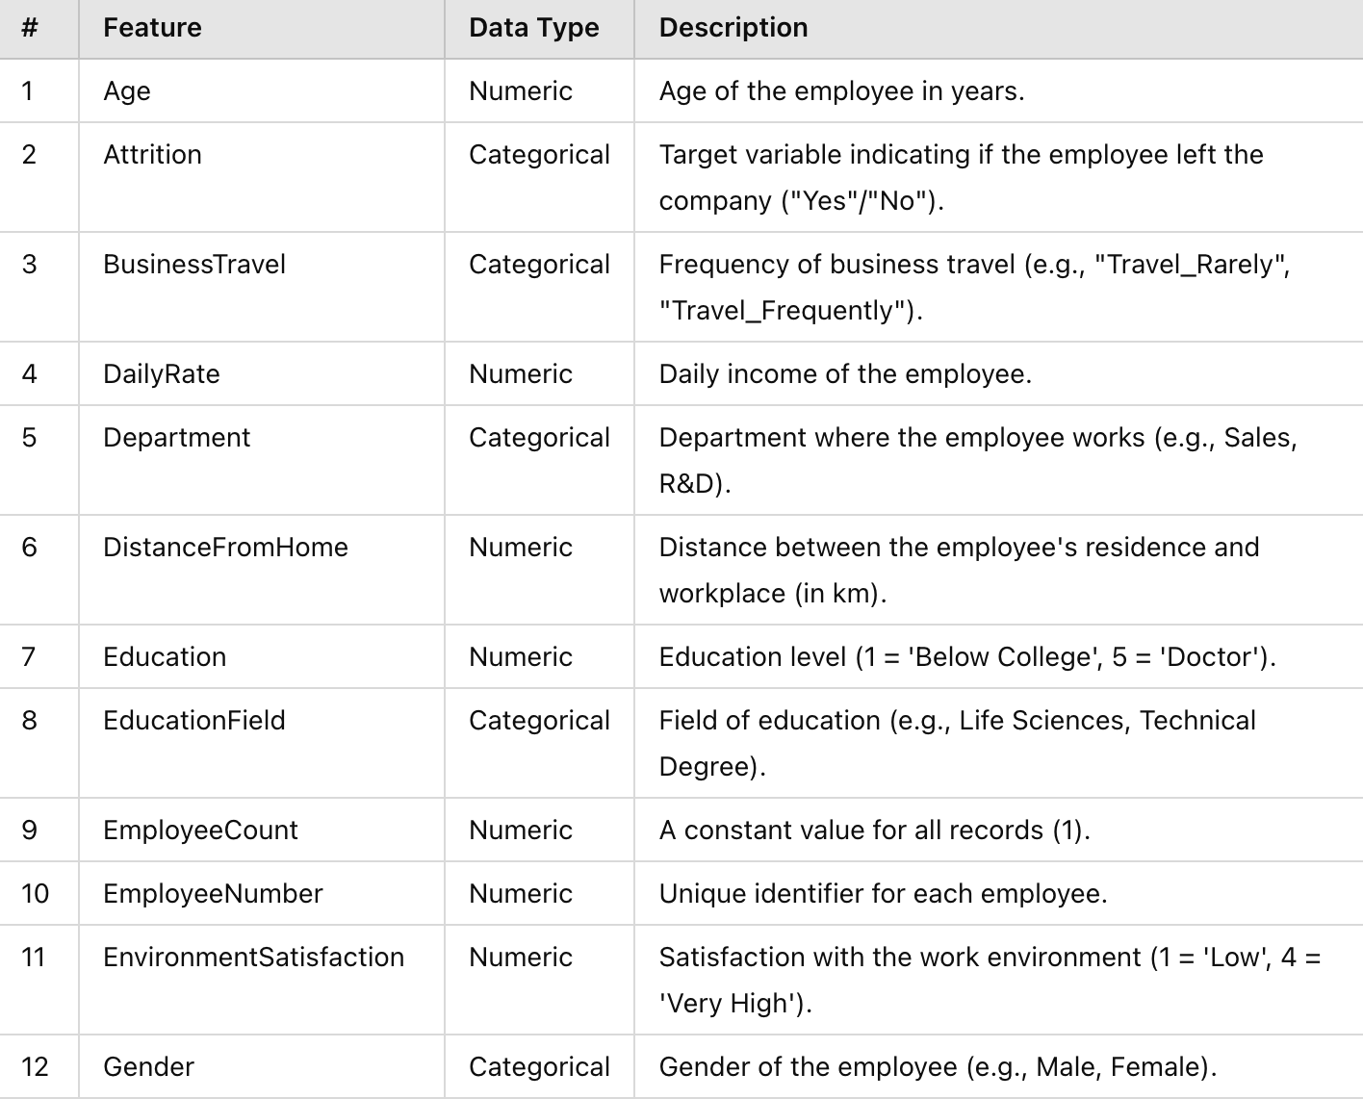
Detailed Column Breakdown

Slide 9
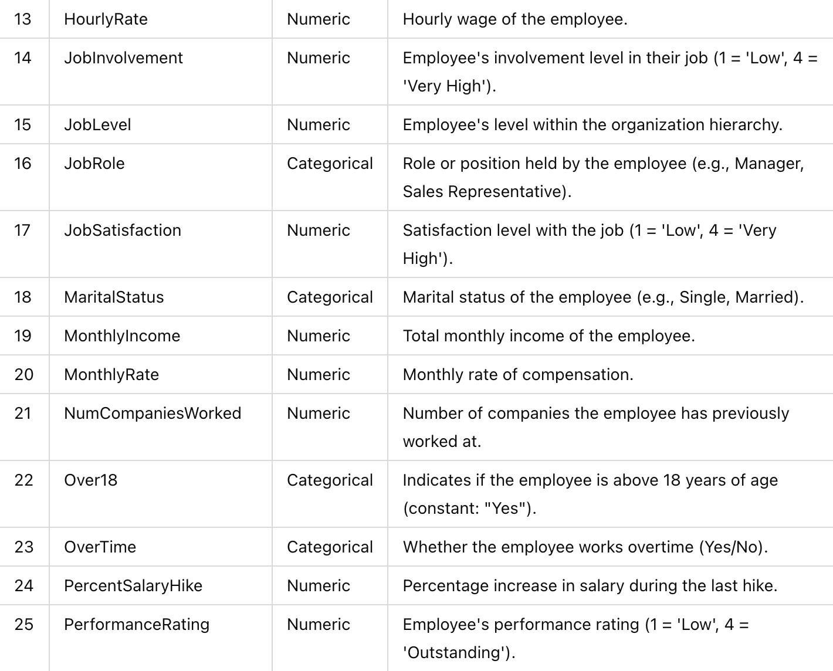
Detailed Column Breakdown

Slide 10
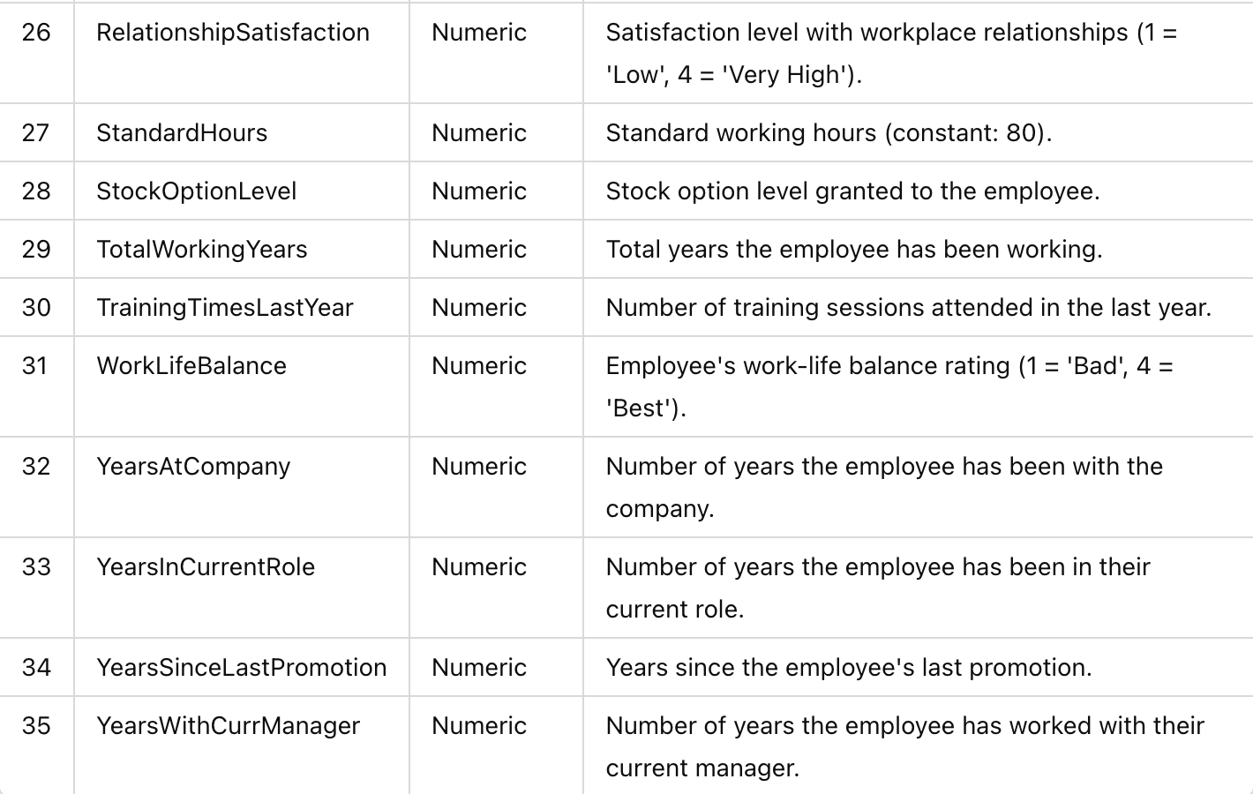
Detailed Column Breakdown

Slide 11
03
Algorithm Choice

Slide 12
I have chosen Random Forest as the primary algorithm for classification.
Random Forest is an ensemble method that combines multiple decision trees to improve prediction accuracy and reduce overfitting.
It is well-suited for this dataset because it handles both categorical and numerical variables effectively.

Slide 13
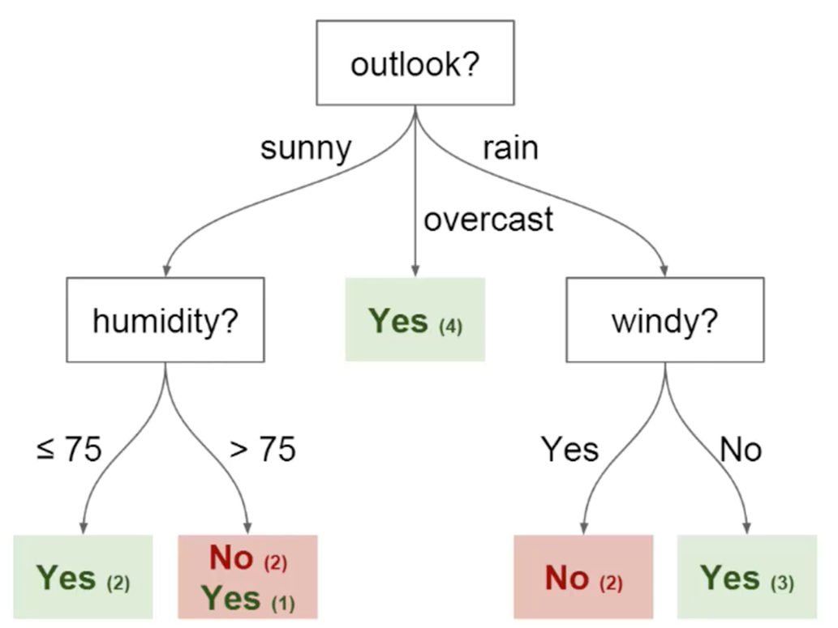
03

Slide 14
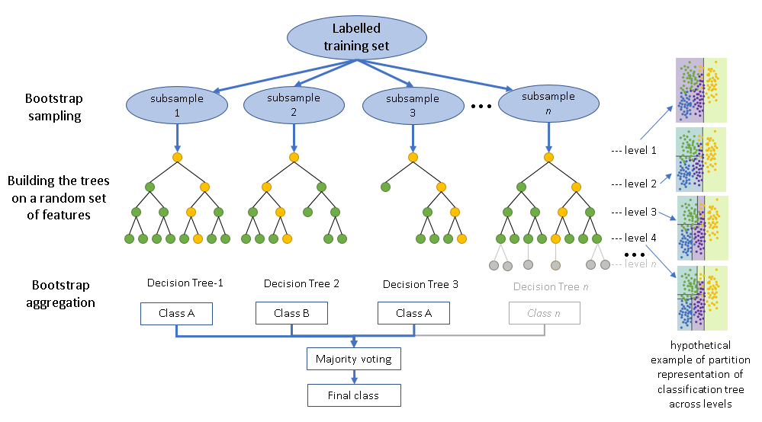
Random Forest

Slide 15
Why Random Forest?
01
02
03
04
05
Handles High-Dimensional Data
Robust to Overfitting
Handles Mixed Data Types
Feature Importance
Resilience to Noise

Slide 16
04
Planned Steps

Slide 17
1
2
3
Exploratory Data Analysis (EDA)
Preprocessing
Model Training

Slide 18
4
5
Evaluation
Interpreting and Informing Results

Slide 19
05
Conclusion

Slide 20
Thanks
Do you have any questions?

